Slide 1
Kubernetes
Timin Kurian

Slide 2
Presentation Overview
What is Kubernetes
Kubernetes Architecture
Pods
Kubernetes Deployment
ConfigMaps

Slide 3
What is Kubernetes?
Kuberenetes is an Open source container orchestration tool
Developed by Google
Helps you to manage containerized application
Host your application in the form of container
Can easily deploy many instances of our application
Featues of Kubernetes are:
High availability or no downtime
Scalability or high performance
Disaster recovery – backup and restore

Slide 4
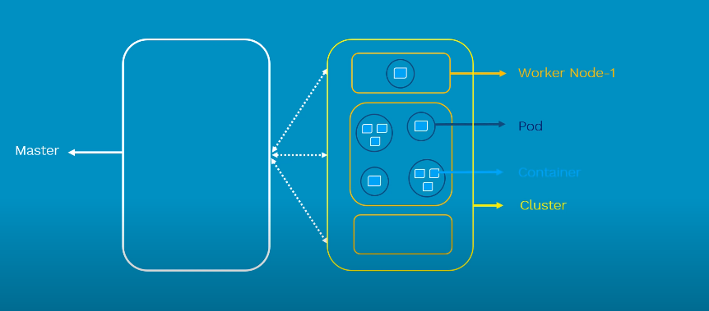
Basic Architecture of Kubernetes

Slide 5
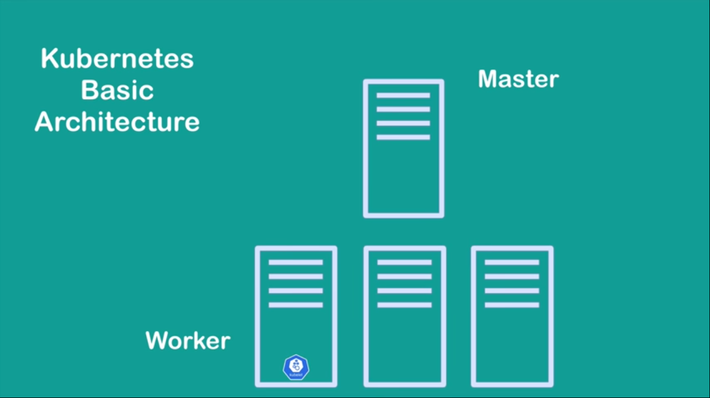
Basic architecture of Kubernetes

Slide 6
Basic architecture of Kubernetes
Kuberentes contains atleast on Master node and couple of worker nodes
Each node has a Kubelet process running on it
Kubelete is a kubernetes process
That makes it possible for the cluster to talk to each other and actually executes some tasks on the nodes
On worker nodes different Docker containers are running
On worker nodes your applications are running
On Master nodes important Kubernetes processes are running that are absolutely necessary to run and manage cluster properly

Slide 7
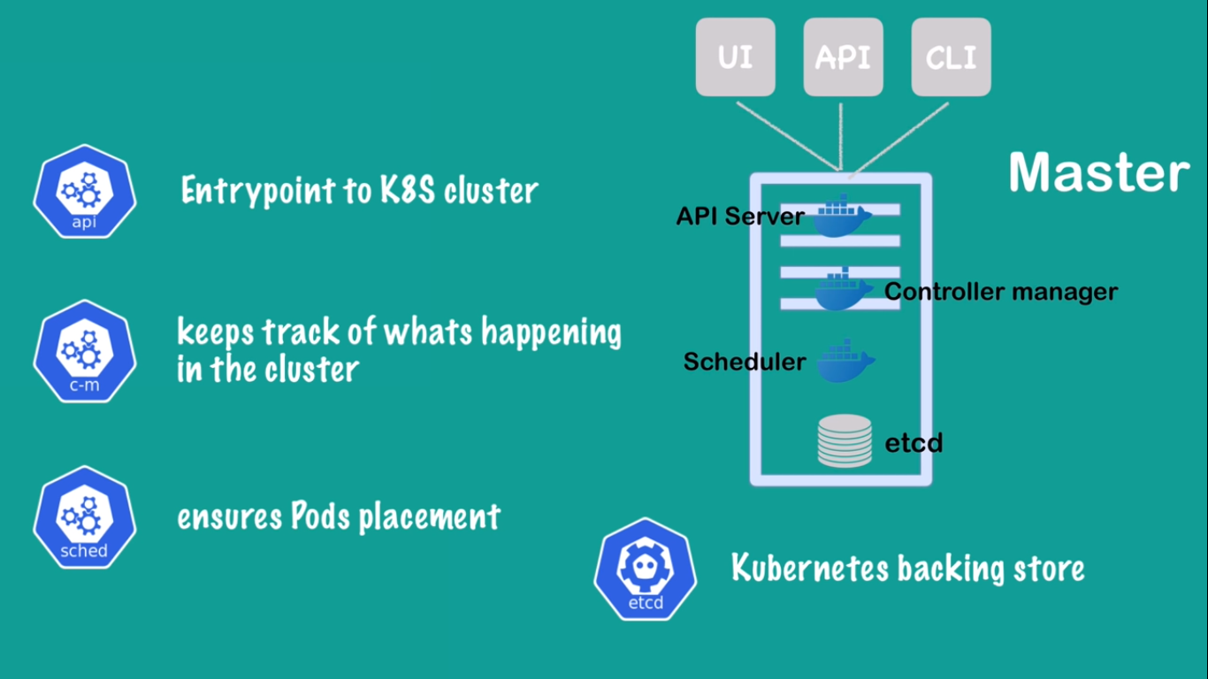
Basic architecture of Kubernetes

Slide 8
Basic architecture of Kubernetes

Slide 9
Pods
Atomic unit of scheduling
Containers are deployed in Pods
Once the pod is deployed into the node it will gets its own IP address
A pod can contains one or more containers
Each container in the pod has their own Port number and these containers have the same IP address
To deploy a pod we generally write pod manifest file which consists of container image that we are able to deploy and submit to the API server on the master node
API server and the scheduler components on master node decides and deploy these ports onto appropriate worker nodes
At least one container in each pod

Slide 10
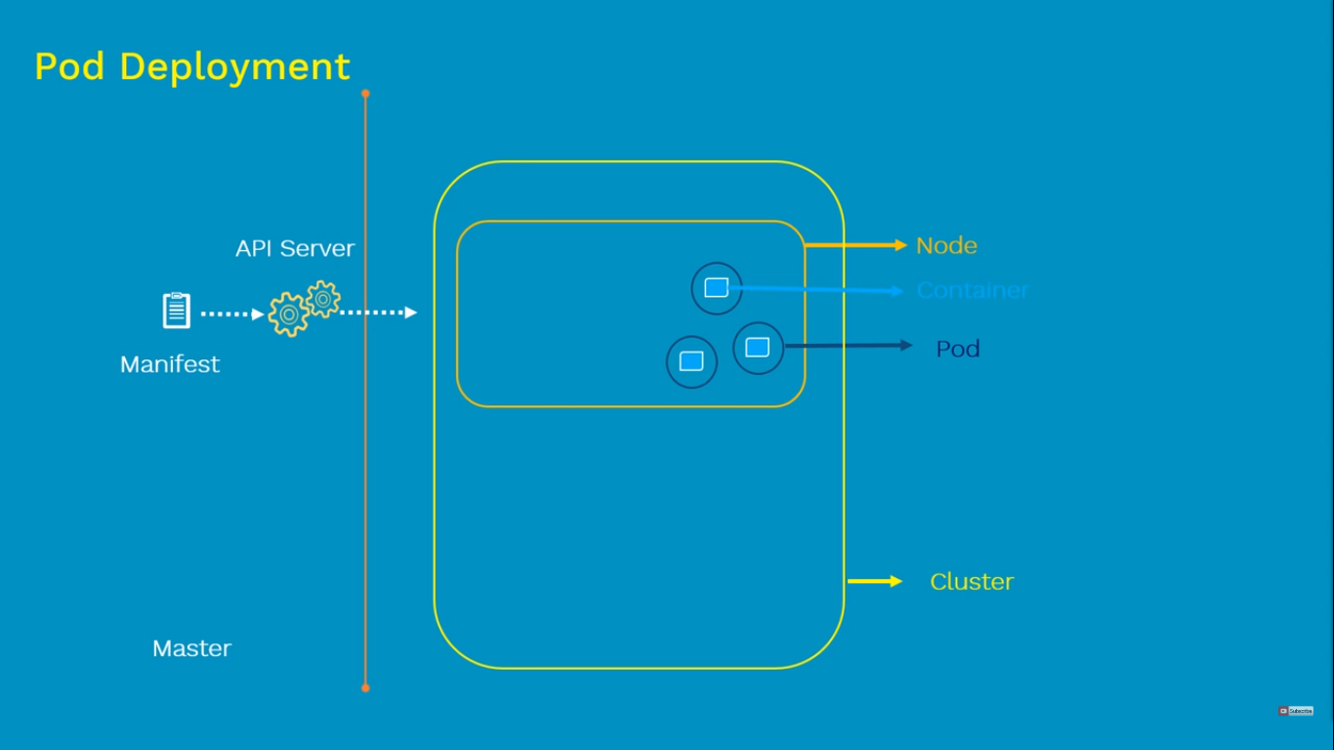
Pods

Slide 11
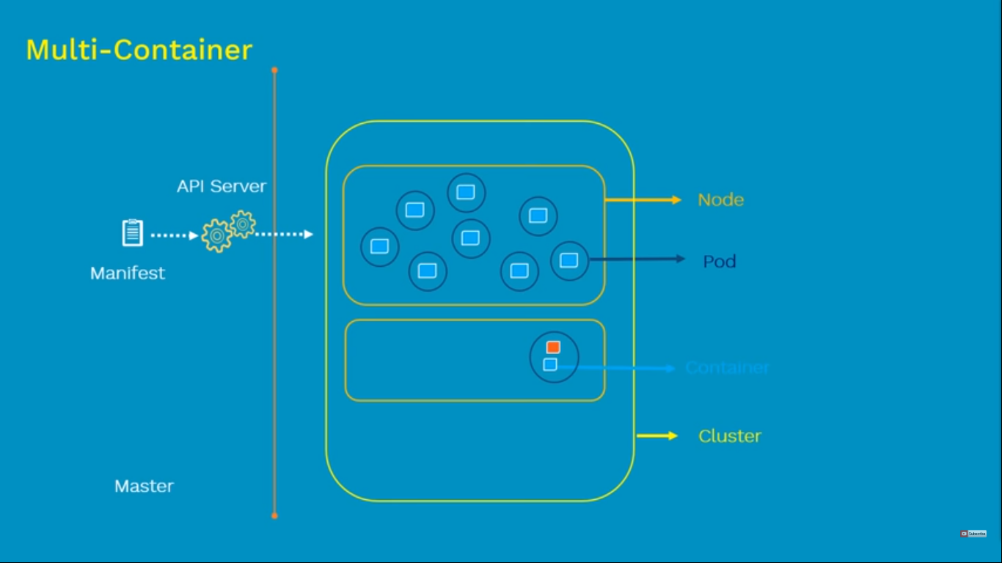
Pods
It is possible to have one or more containers in a single pod
In some cases we need a helper container to support our main container to complete its task, so that time we use multiple containers
When the app container dies the helper container also dies

Slide 12
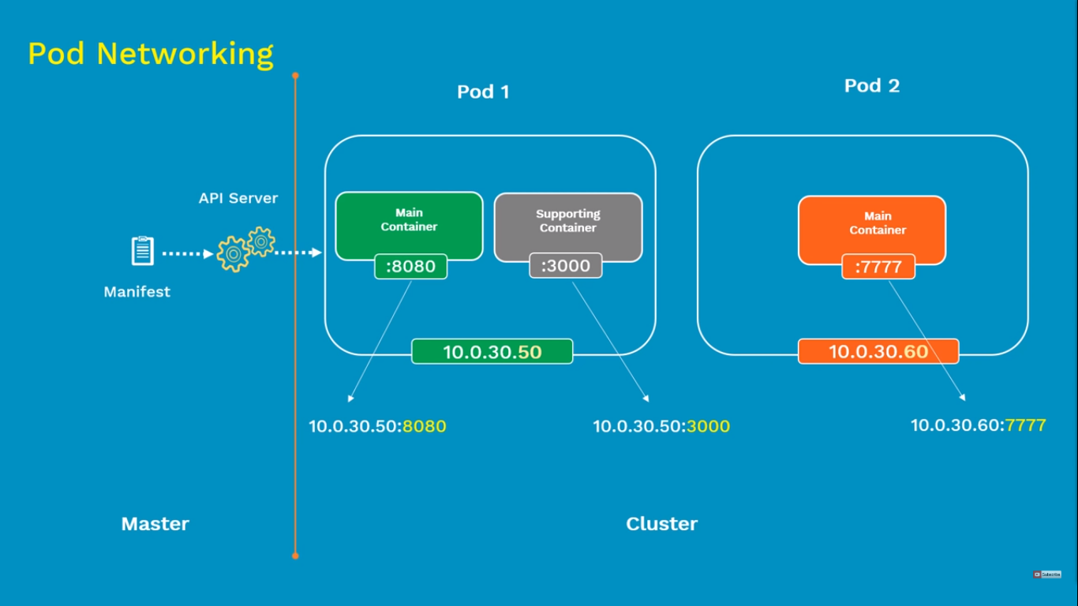
Pods
Every pod inside the worker node has its own IP address
Every containers inside the pod has its own Port number
Containers within the same pod shares the same ip address, access to the same volumes etc.

Slide 13
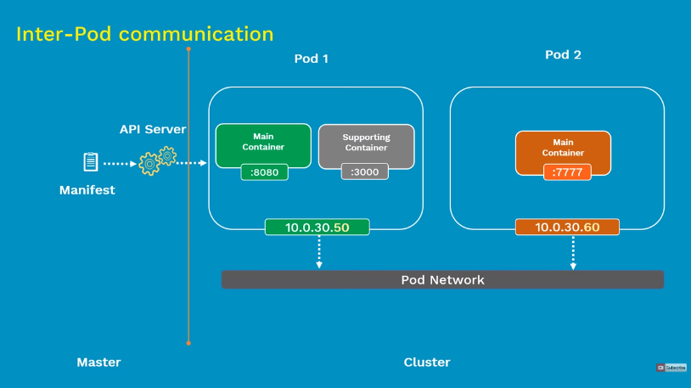
Pods
Pods communicate with each other is called inter-pod communication
All the pods IP address are fully routable on the pod network inside the Kubernetes cluster

Slide 14
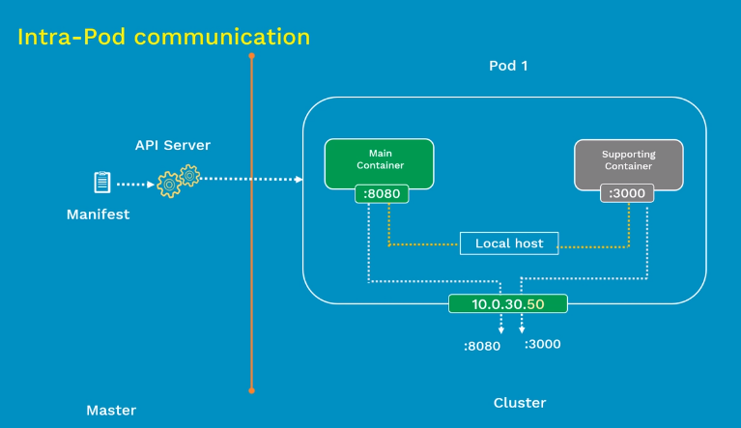
Pods
Communication of containers in the same pod is called the Intra-Pod communication
They all top over using shared local host interface
Each containers can directly communicate with each others port on local host
Within the same pod they all shares the same IP address and the network namespace

Slide 15
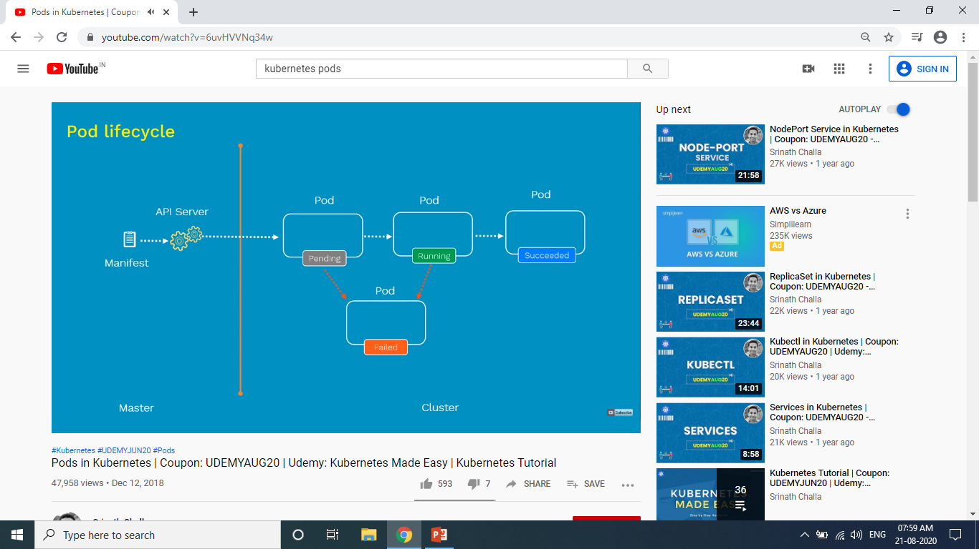
Pods
Define the pod configuration on the Pod manifest file in yaml or json format then submit the file at the API server on Master
It will create a worker node inside the Kubernetes cluster. Once that is scheduled it goes into the Pending state
During the pending stage the node will download all the container images and starts running the container
If all the containers are up and running it goes into the Running state
In the running state the pod is achieved its main purpose then it is shutdown and state changed to succeeded state.
When the node fails it moved to the Failed state.

Slide 16
Pods
Define the pod configuration on the Pod manifest file in yaml or json format then submit the file at the API server on Master
It will create a worker node inside the Kubernetes cluster. Once that is scheduled it goes into the Pending state
During the pending stage the node will download all the container images and starts running the container
If all the containers are up and running it goes into the Running state
In the running state the pod is achieved its main purpose then it is shutdown and state changed to succeeded state.
When the node fails it moved to the Failed state.

Slide 17
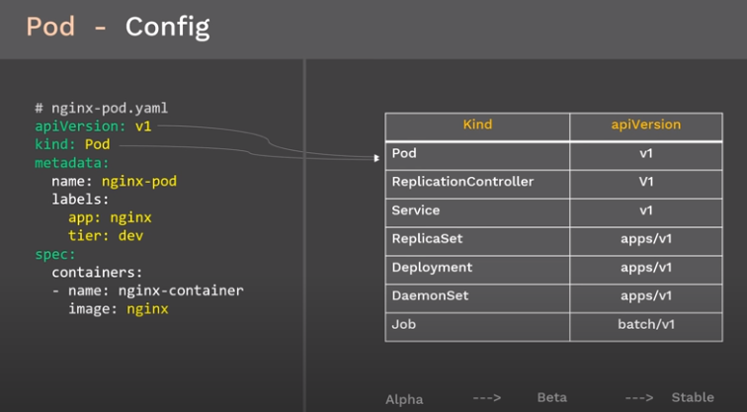
Pods
ApiVersion defines the version number which this Kubernetes object belongs too
Kind is the type of the object
V1 means first stable release of that object
apps/v1 is the functionality related to running apps on Kubernetes
batch/v1 conatins object related to batch processes
Metadata consist of 2 things
Name is the name of the object we are creating; our case it is the name of the pod
Labels are the tags given to the pod; it helps in the case of filtering
We need to specify the container configuration under the spec

Slide 18
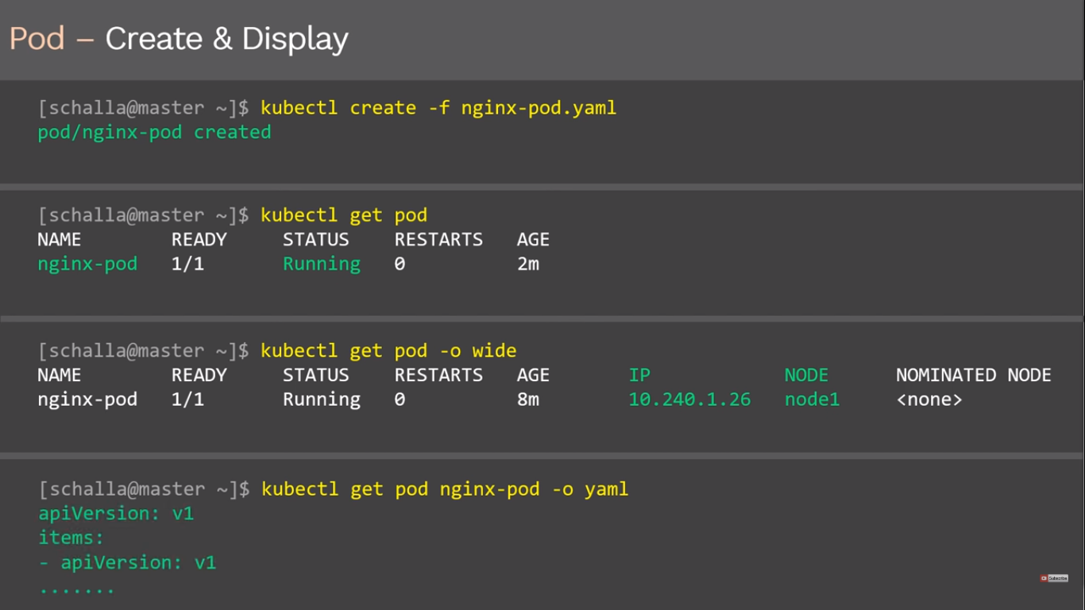
Pods

Slide 19
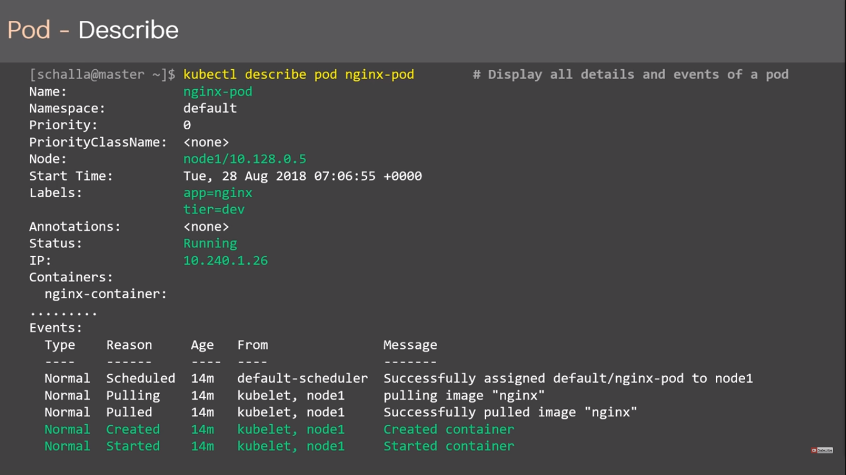
Pods

Slide 20
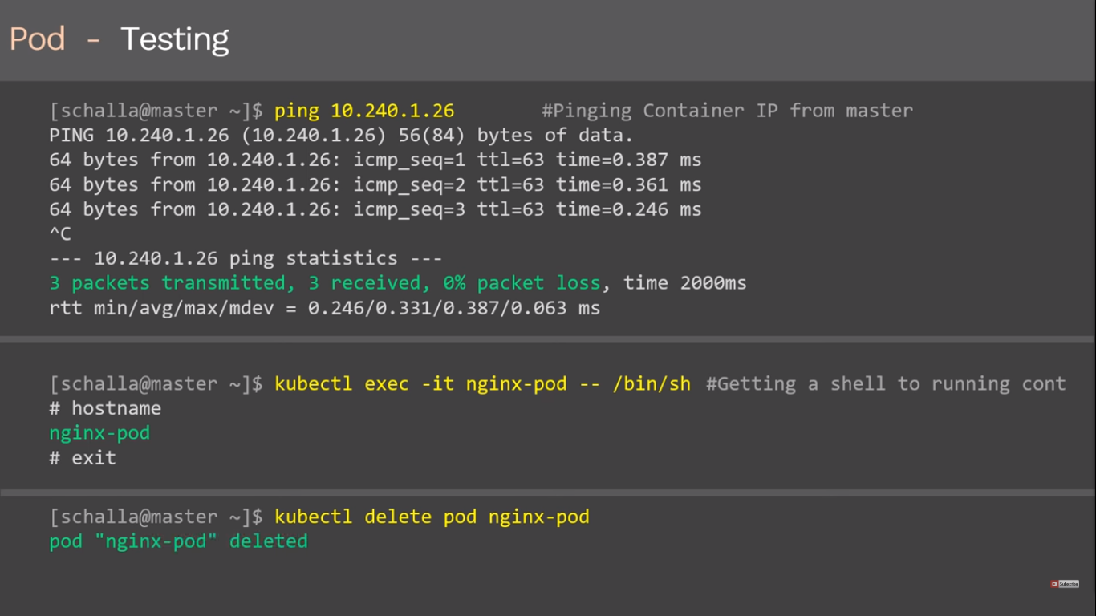
Pods

Slide 21
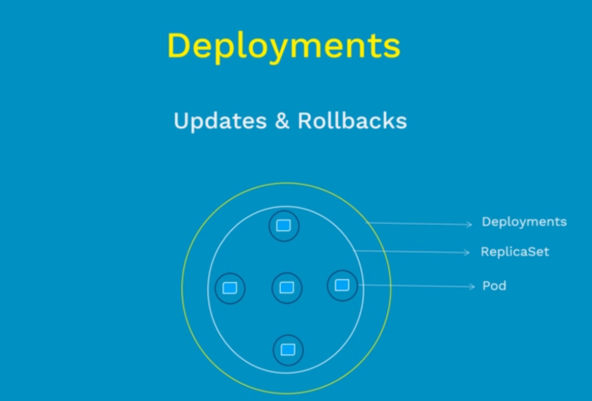
Deployments
Deployments represent a set of multiple, identical Pods with no unique identities.
A Deployment runs multiple replicas of your application and automatically replaces any instances that fail or become unresponsive.
In this way, Deployments help ensure that one or more instances of your application are available to serve user requests.
Deployments are managed by the Kubernetes Deployment controller.
We are deploying application of multiple instace by help of replicaset
It doesn’t support updates and rollback

Slide 22
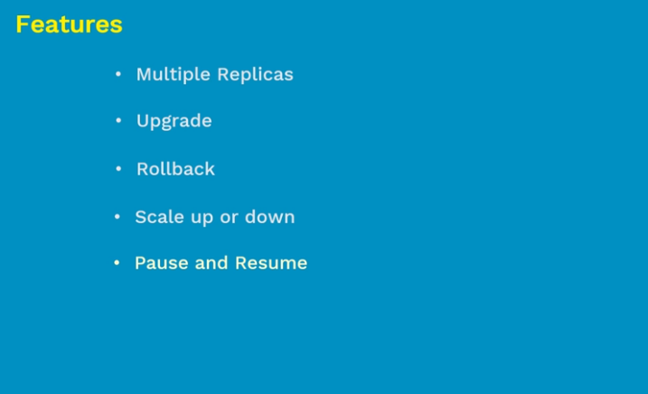
Deployments

Slide 23
Deployments
DEPLOYMENT TYPES
Recreate
Rolling Update (Ramped or Incremental)
Canary
Blue/Green

Slide 24
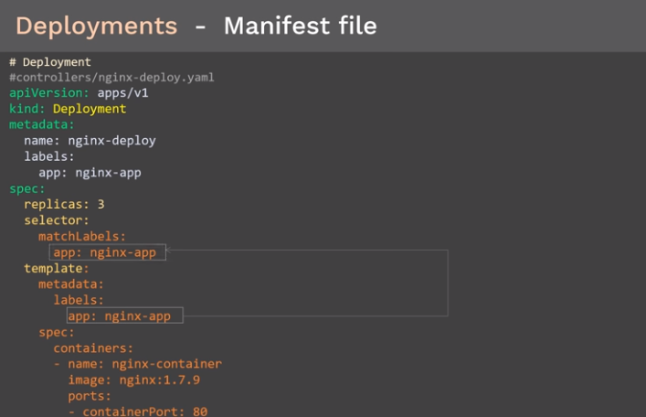
Deployments

Slide 25
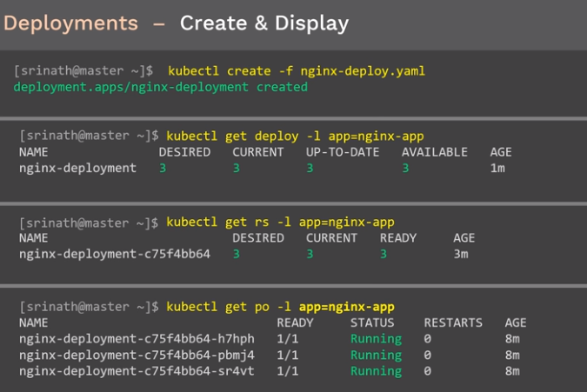
Deployments

Slide 26
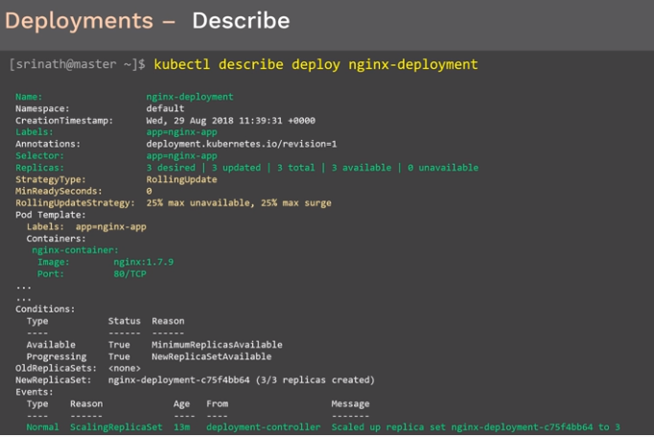
Deployments

Slide 27
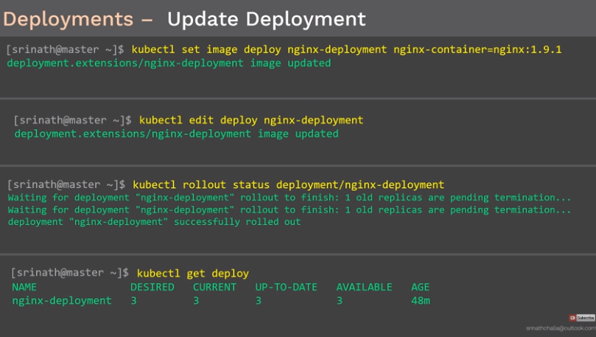
Deployments

Slide 28

Deployments

Slide 29
Deployments

Slide 30
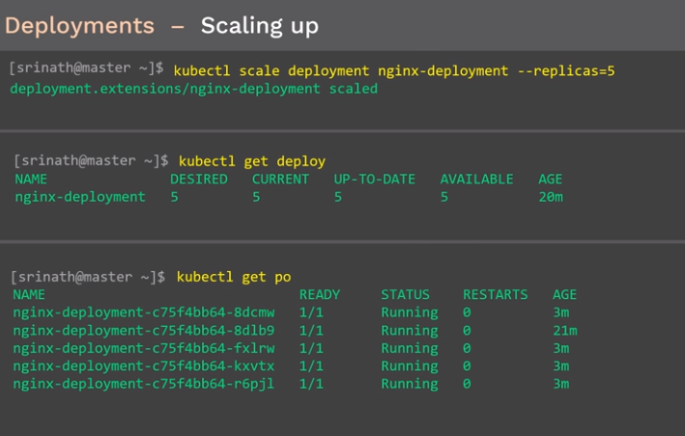
Deployments

Slide 31

Deployments

Slide 32
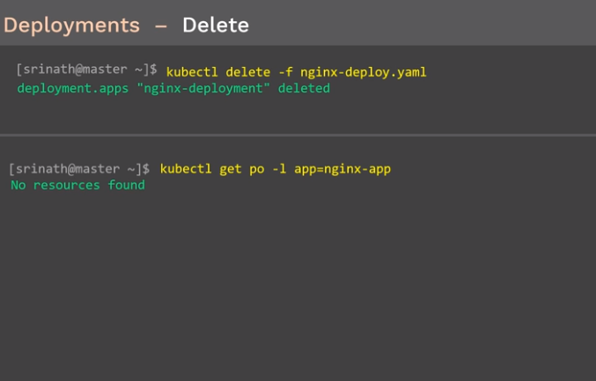
Deployments

Slide 33
ConfigMaps
Container images are build to be portable
Containers expect configuration from
Configuration files
Command line arguments
Environment variable
INI – XML – JSON – Custom format
ConfigMap is a kubernetes objects which allows you to separate your configuration from pods and components
Stores configuration data as a key – value pair
Similar to secrets but don’t contain sensitive information
You must create a configmap before referencing it in a pod spec

Slide 34
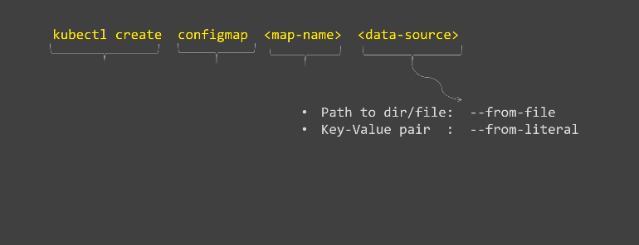
ConfigMaps
Creating ConfigMap

Slide 35

ConfigMaps

Slide 36
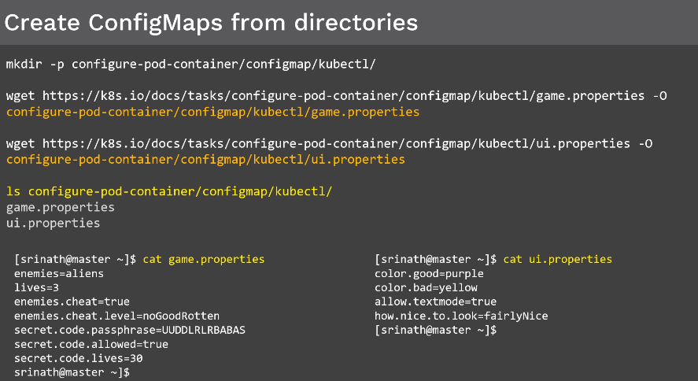
ConfigMaps

Slide 37
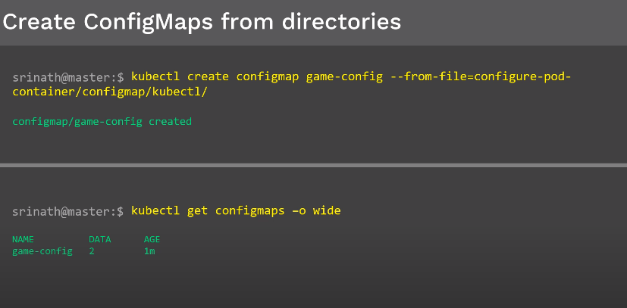
ConfigMaps

Slide 38
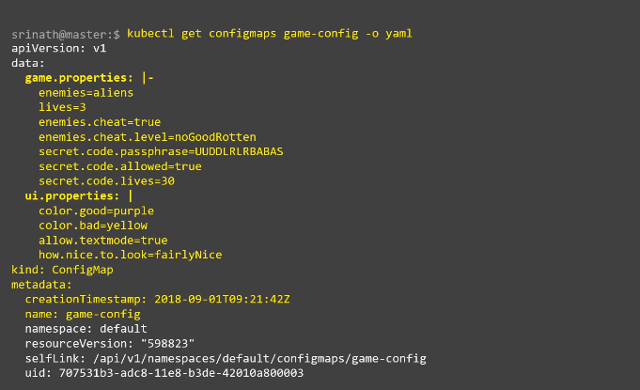
ConfigMaps

Slide 39
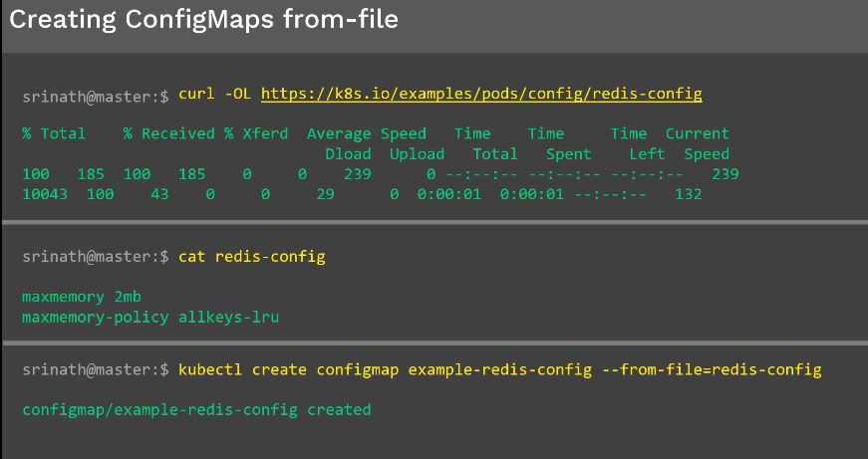
ConfigMaps

Slide 40
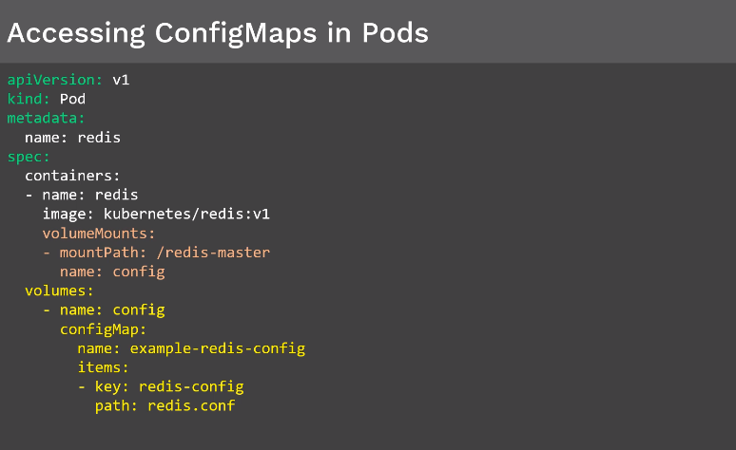
ConfigMaps

Slide 41
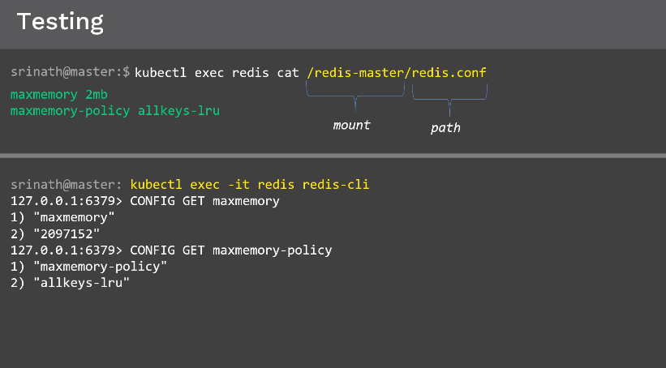
ConfigMaps

Slide 42
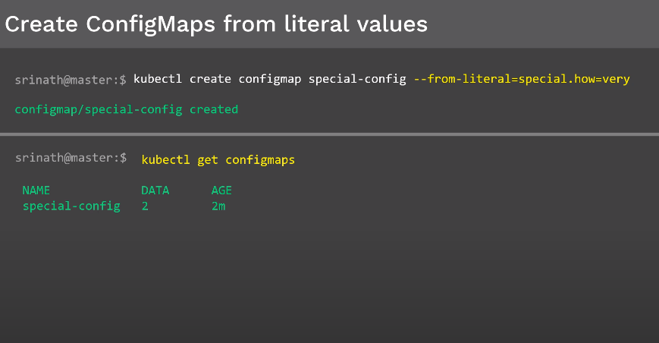
ConfigMaps

Slide 43
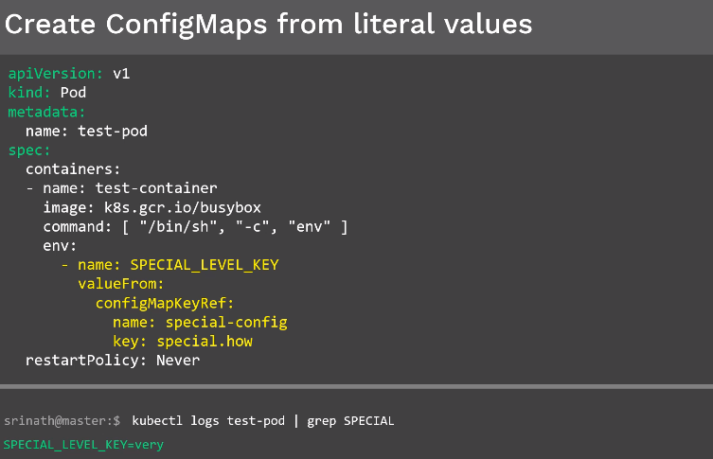
ConfigMaps

Slide 44
Thank You

